Slide 1
Form groups of 3-4 people
Use discussion board to continue to explore groups based on cancer gene function/pathway/cancer type/other commonality
Self assign to groups on canvas

Slide 2
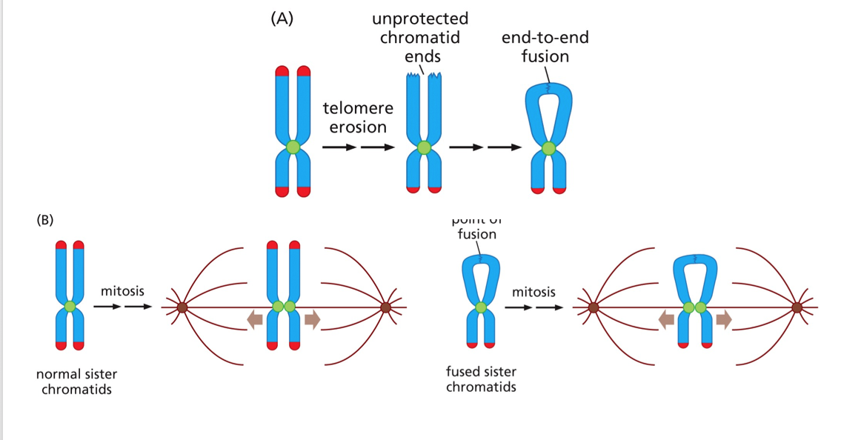
Break-Fusion-Bridge cycle limits cell viability
Telomere end replication problem → short telomeres and DNA damage signaling
Fuision ‘repairs’ the damage
‘Repair’ promotes more daamge

Slide 3
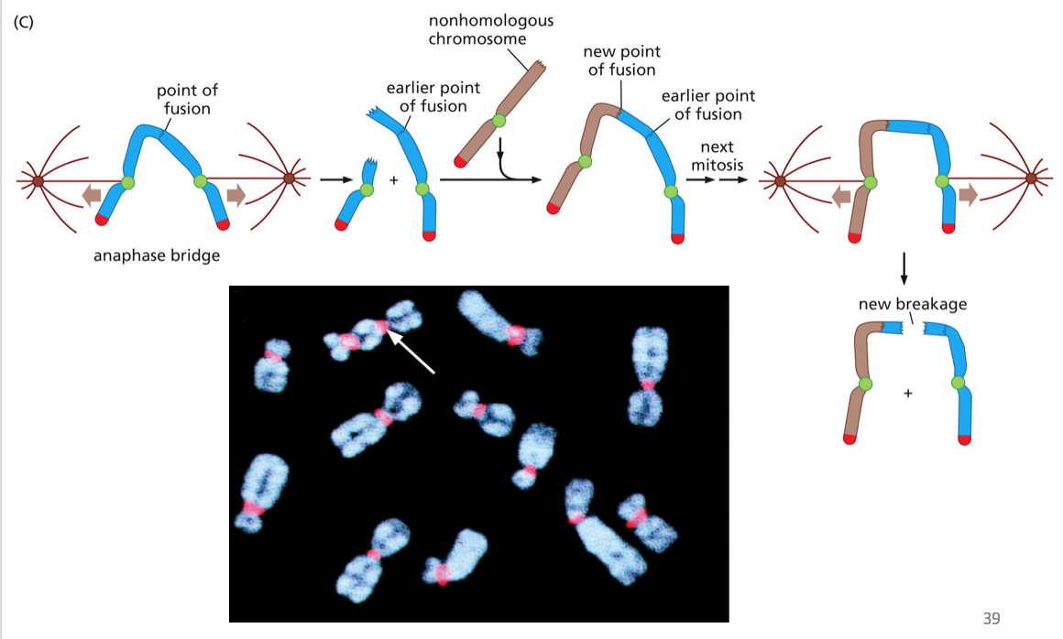
Break-Fusion-Bridge cycle limits cell viability

Slide 4
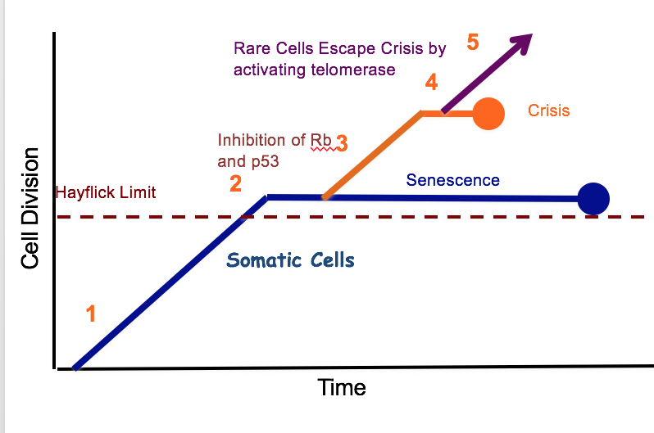
Pathway to immortality
pRB and p53 loss allow bypass of senescence
Still sensitive to crisis → cell death
Cancer cells MUST overcome crisis

Slide 5
Dealing with crisis
Telomerase to provide a primer template and solve the ‘end replication problem’ → all telomeres get long again
ALT to use other telomeres as a replication template → telomeres get long again (can be very variable in length)

Slide 6
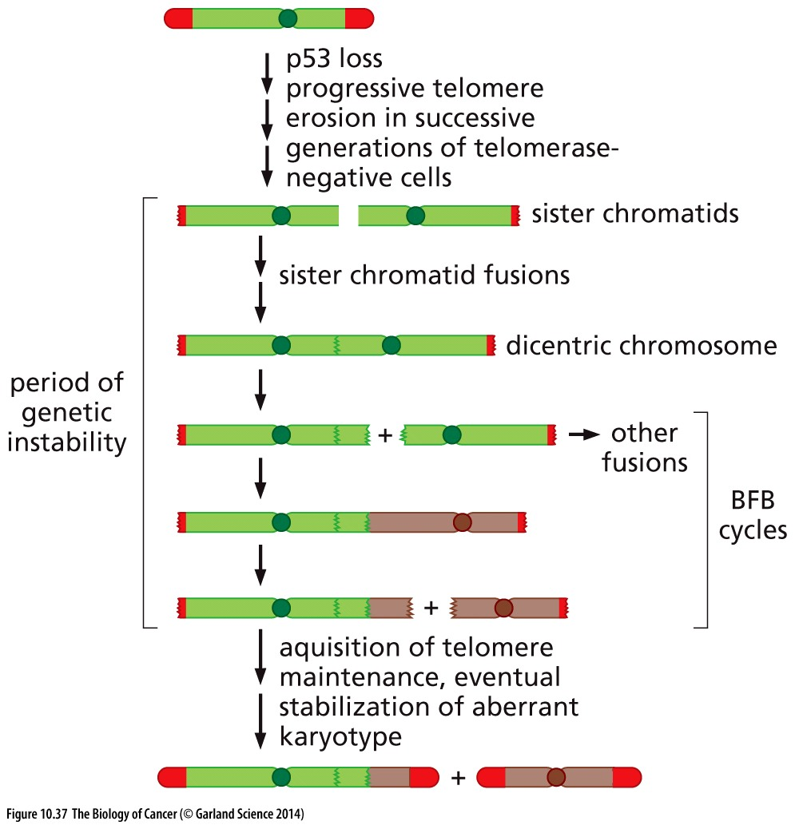
Crisis PROMOTES cancer?!
Break-fusion-break cycles create dramatic genetic instability
BFB is mutation-promoting
A cell that survives this initial assault may acquire hTERT activation or ALT mechanisms to stabilize telomeres and promote immortalization

Slide 7
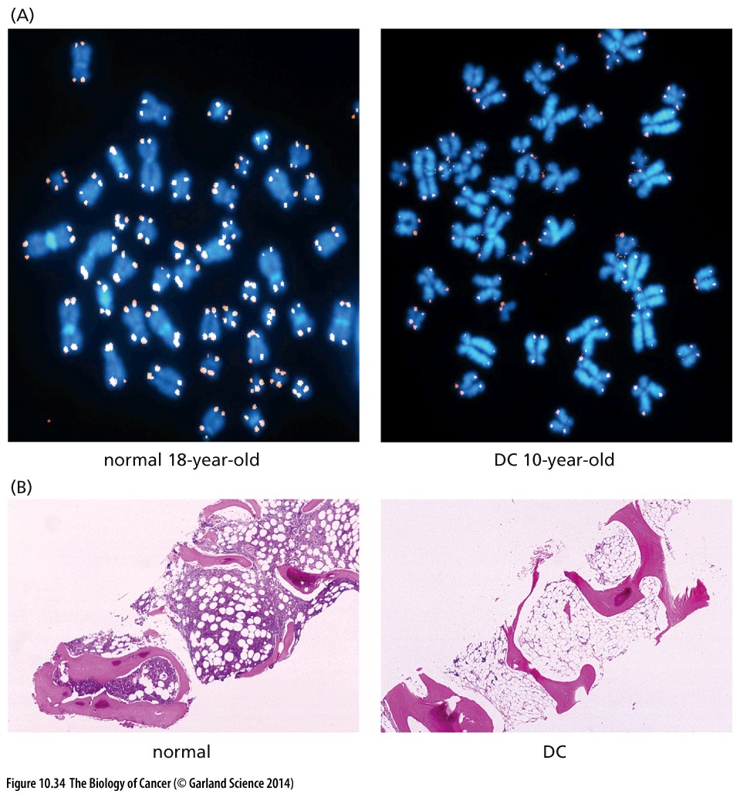
Telomerase defects in disease
Telomerase is needed in highly regenerative tissue (skin, bone marrow)
Mutations in telomerase co-factors result in premature telomere shortening
Cells go into crisis and patients experience a collapse of their hematopoietic system
OR they develop leukemia?!

Slide 8
Lecture 12 objectives
Chapter 11: Multistep Tumorigenesis
Be able to describe how/why tumors of the same type may be genetically different in different patients
Be able to describe how/why cells from within the same tumor may be genetically different from each other

Slide 9
Tumor development takes time
Pre-cancer/cancer cells don’t just grow over time, they change
What are these steps?
Think-pair-share:
What cellular changes must happen to allow a tumor to form?
write it out on your whiteboard

Slide 10
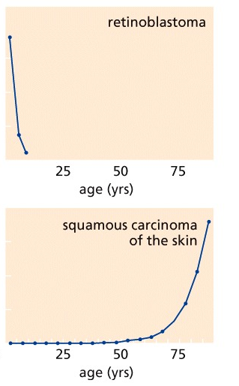
Which cancers likely have fewer steps? Which have more?
Not all about age!
Why might cancers of different origins need fewer transformative mutations
Availability of cancer precursor cells:
Retinoblastoma derives from undifferentiated retinal precursor cells → only available in first few years of life
Is this the same or different as cancers needing more or less time to develop?
Different! Time to develop cancer may reflect all of the above AND intrinsic rates of damage, carcinogen exposure, tissue proliferation rate
relative incidence
relative incidence
Typical adult onset cancer kinetics

Slide 11
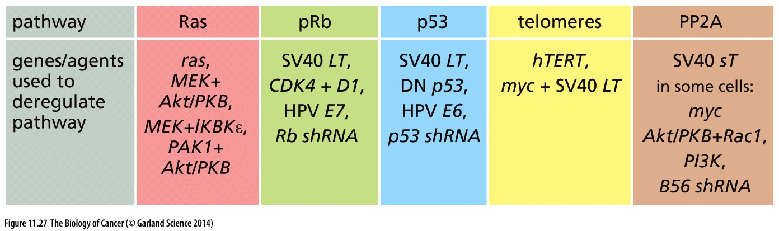
Decades of precancer growth
What happens over this long period of time?
Experimentally determined multistep tumorigenesis must deregulate 5 pathways:
Activate tumor suppressors that bypass mitogenic signaling
Inactivate tumor suppressors that enforce cell cycle chkpt
Inactivate tumor suppressors that enforce the ‘alarm’ chkpt
Bypass replicative senescence and crisis
Deregulation of PP2A –regulated proliferation

Slide 12
Decades of precancer growth
What happens over this long period of time?
Experimentally determined multistep tumorigenesis must deregulate 5 pathways:
Activate tumor suppressors that bypass mitogenic signaling
Inactivate tumor suppressors that enforce cell cycle chkpt
Inactivate tumor suppressors that enforce the ‘alarm’ chkpt
Bypass replicative senescence and crisis
Deregulation of PP2A pathway
Mix and match to de-regulate all 4 (5) = cancer

Slide 13
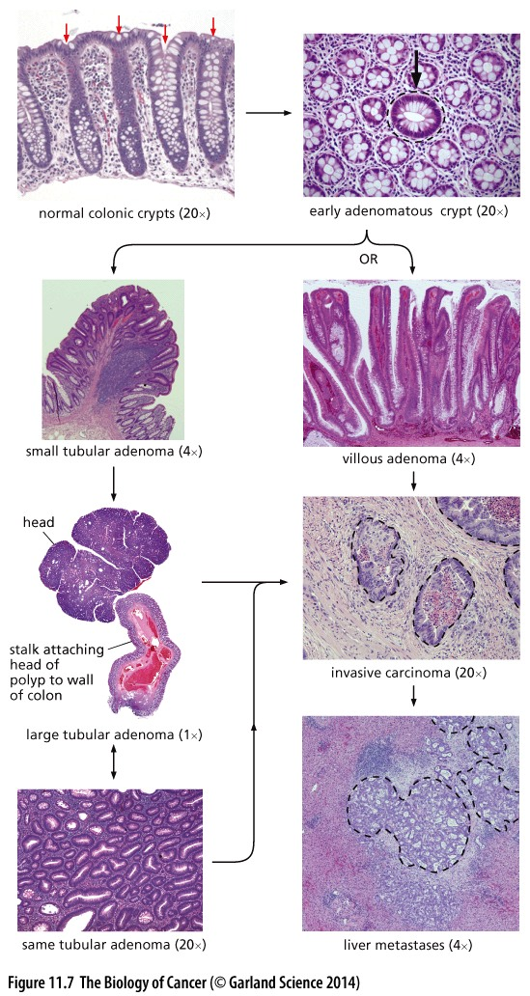
Each pathway disruption represents a rate-limiting step
How do we know?
We can ’see’ these steps with histopathology
Abnormal tissues can be ordered by how much they deviate from normal tissue structure
Overproliferation
Disordered structure
Invasion through the basement membrane
metastatic
How do we know these are ‘steps’ and not different final stages?
Increasing abnormality

Slide 14
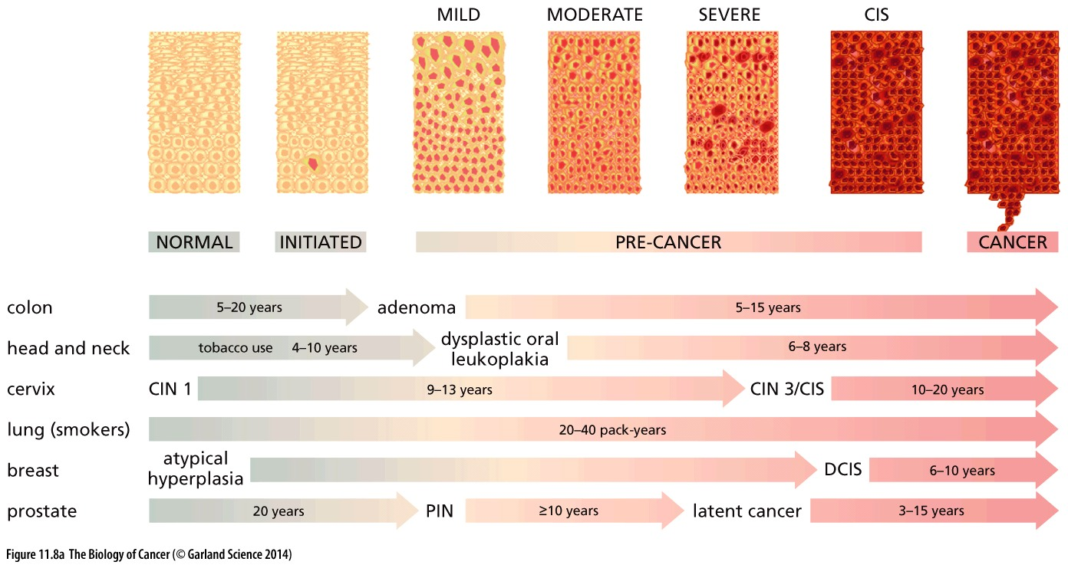
Each pathway disruption represents a rate-limiting step
How do we know?
It’s logical and we can deduce from how different ‘steps’ correspond with patient risk & outcome
Nomenclature in different cancers is different, but the progression is remarkably similar!

Slide 15
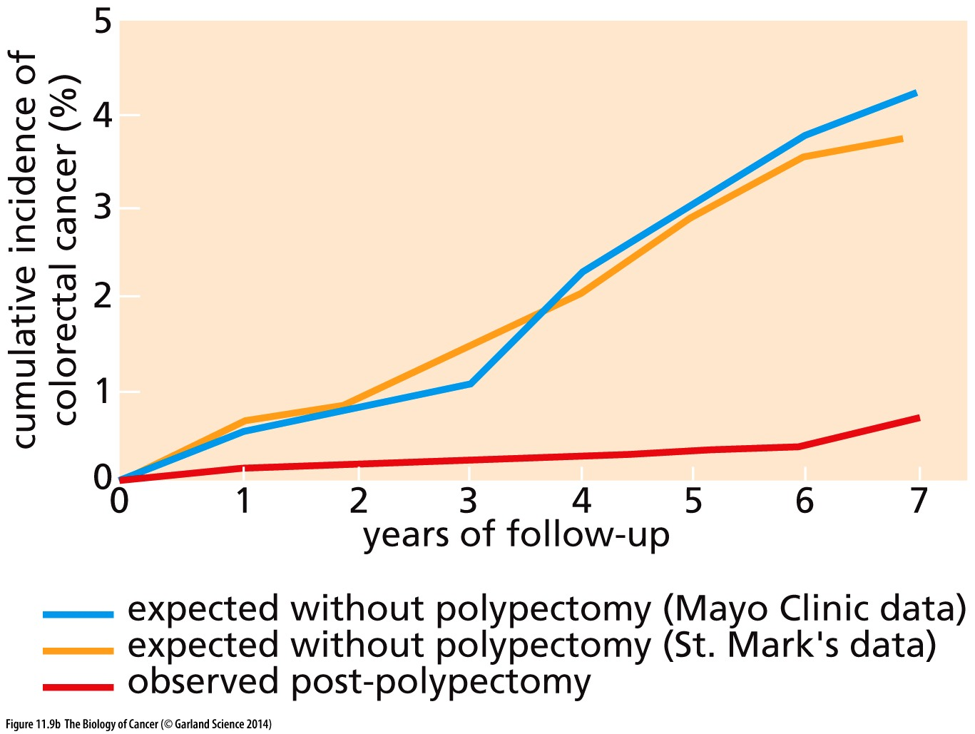
Each pathway disruption represents a rate-limiting step
How do we know?
Disrupting a ‘precursor’ prevents the ‘product’
Polyps are believed to precede invasive carcinoma
Removing pre-cancerous polyps from the colon prevent colorectal cancer from developing

Slide 16
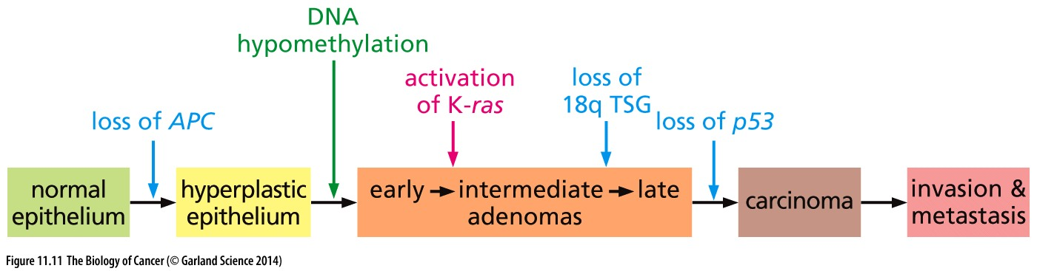
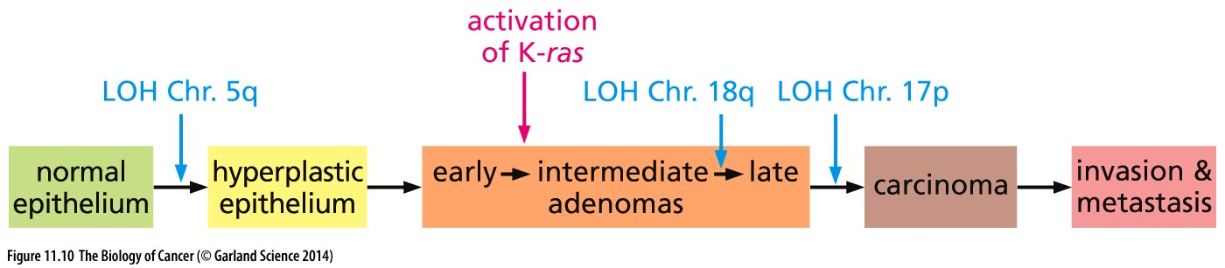
Each pathway disruption represents a rate-limiting step
How do we know?
Genetic analysis tells us so!
As tissue progressed from normalcy to high grade malignancy they accumulate increasing #s of mutations
By studying the acquisition of mutations at progressive stages of tumorigenesis, scientists began to define the sequence of mutations needed to promote cancer
(most of) the cancer genes themselves were revealed later

Slide 17
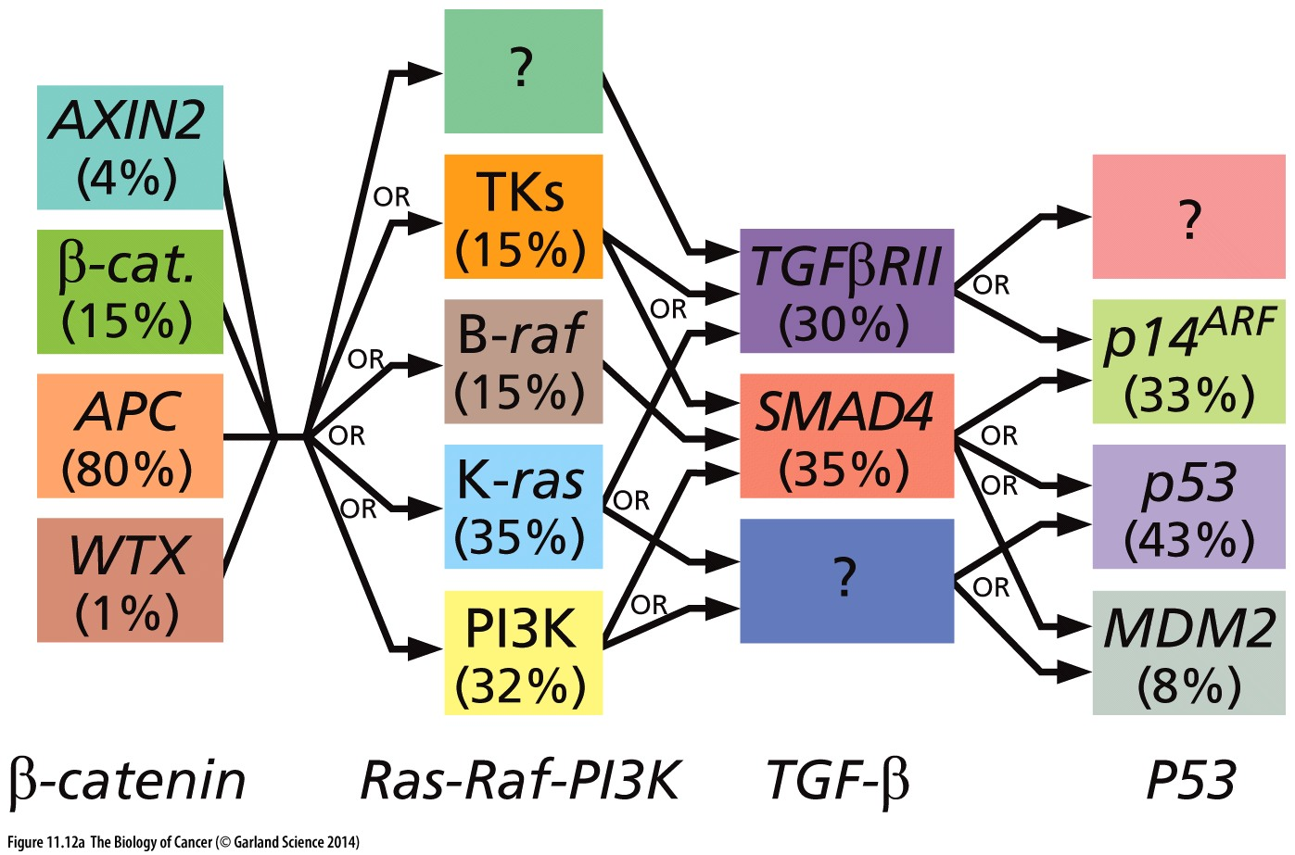
Many roads to the same destination
Original definition of genetic cancer progression in colon cancer indicates the pathways that need to be inactivated, not the specific genes
Disruption of any one of a number of different genes that impact a pathway can lead to the same progression
Does pathway inactivation have to happen in this order?

Slide 18
Order of cancer mutations
Think-pair-share:
Back to your whiteboards → can you order your 5-6 rate-limiting steps of tumor progression as they might appear in a developing tumor?
Consider the progression of colon cancer below:
MUST activation of K-ras happen before p53 loss? Why/why not?
Germline APC mutations virtually ensures an individual will develop colon cancer. Why?

Slide 19
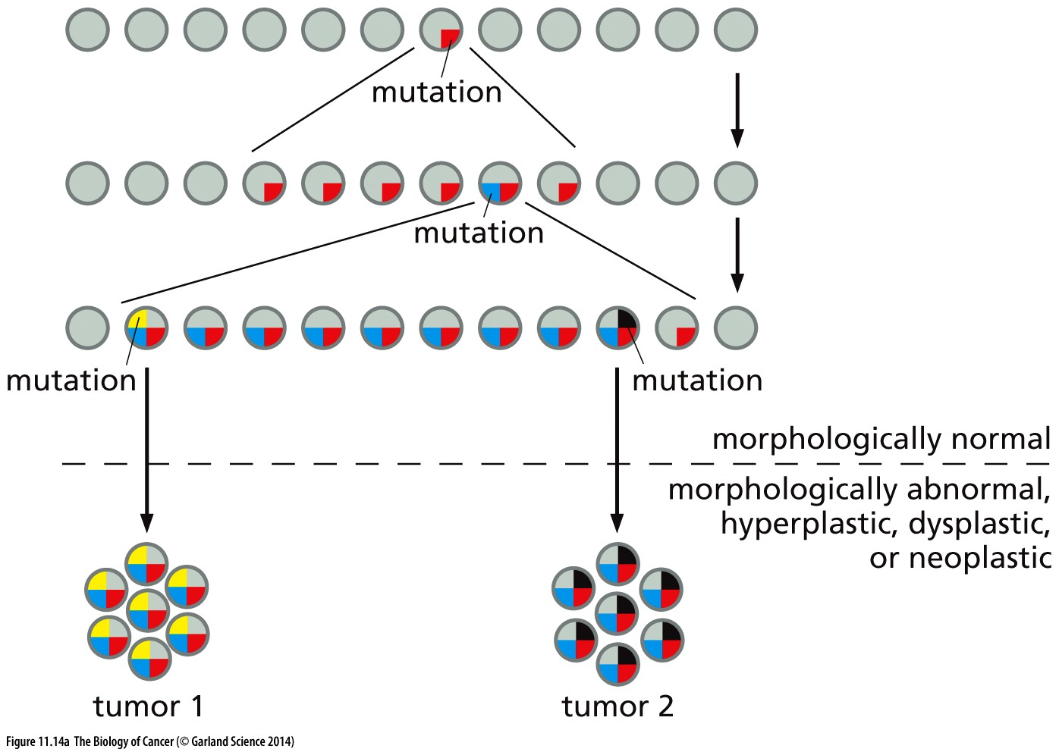
Distinct tumors with a common origin
Mutations in cancer genes are random and infrequent
‘Rate-limiting’ steps mean precancerous cells can persist, poised to become cancerous with an additional mutation(s)
Step #1
Step #2
Step#3
Multiple, seemingly distinct tumors can arise from the same original cell
Is this more likely to happen at an earlier or later step in tumorigenesis?

Slide 20
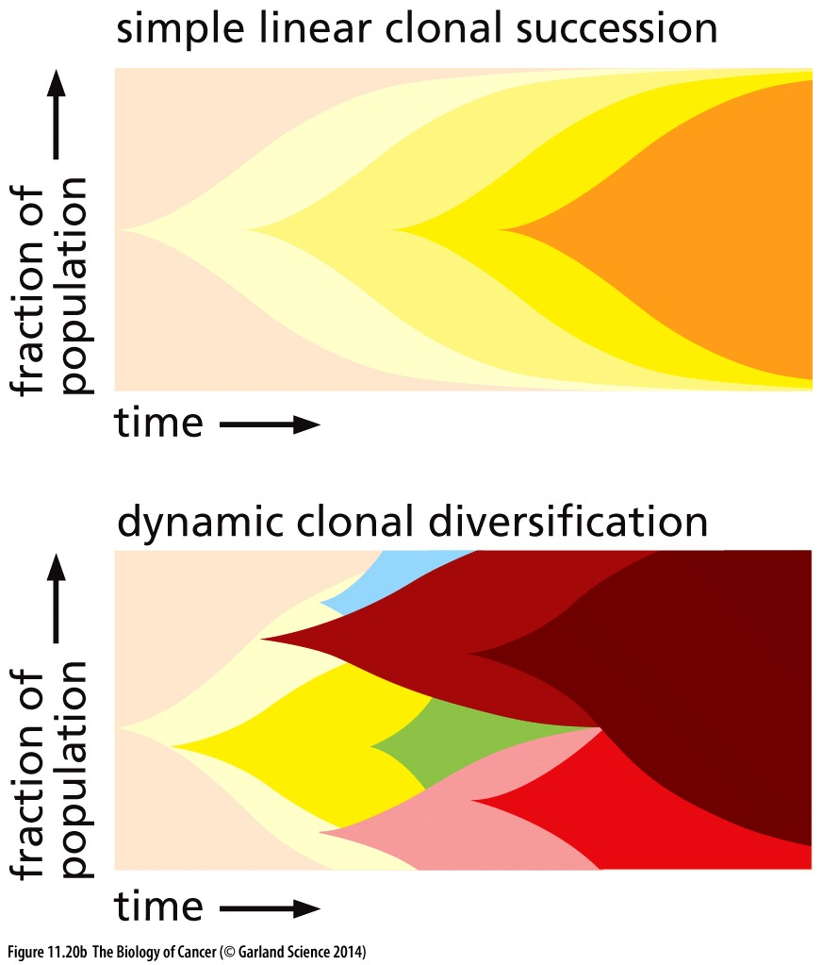
Cancer development is clonal
All cells in a tumor evolve from the same original cell
A linear model would have one cell progressing through each rate-limiting step
The growth advantage this cell gains would allow it to outgrow cells stuck at earlier stages
Tumor would be homogeneous
Not what we see!

Slide 21
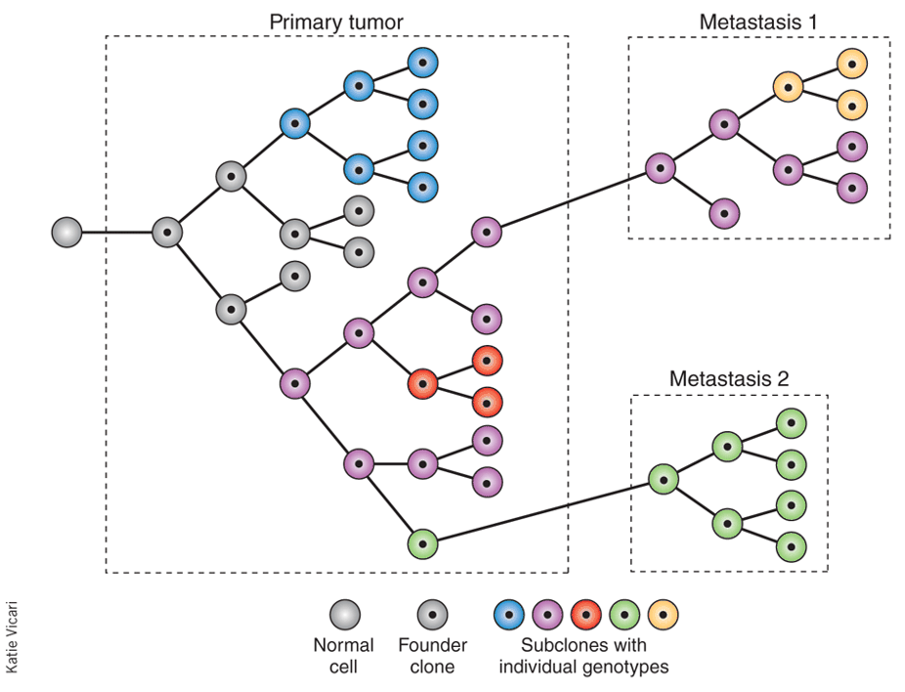
Cancer development is clonal
But NOT linear
Sub-clones can individually evolve/gain new mutations → cells with mutations that increase fitness proliferate more/faster
Consequences:
‘independent’ tumors
tumor heterogeneity

Slide 22
Drivers and Passengers
Acquisition of mutations during tumor development is ongoing
Mutagenesis is random and cancer progresses only in the infrequent event when mutation occurs in a cancer gene that governs a rate limiting step
Other mutations are permitted to accumulate so long as they don’t decrease fitness
Driver mutations promote/are necessary for tumor progression
Passenger mutations are along for the ride

Slide 23
Not all carcinogens are mutagenic
Carcinogens that are mutagenic can provide initiating mutations
Carcinogens that are not mutagenic may simply promote cell proliferation
Cell non-autonomous activation of growth factor signaling
Induce wounds to promote tissue regeneration
Increased proliferation in the presence of a mutagen can accelerate tumorigenesis

Slide 24
Cancer initiators and promoters
Initiating mutations can lie dormant long periods of time
A cancer promoter can ‘unmask’ the initiating mutation by increasing proliferation → can be non-genetic and transient
Cellular promoters:
Hormones induce cell proliferation: more hormonal cycles → increased risk of breast cancer
Alcohol kills epithelial cells in the throat, promoting their regeneration → cooperates with smoking to promote head and neck cancer
Chronic inflammation (colitis, Crohns, gallstones, hep B) → promotes cancers at sites of inflamation

Slide 25
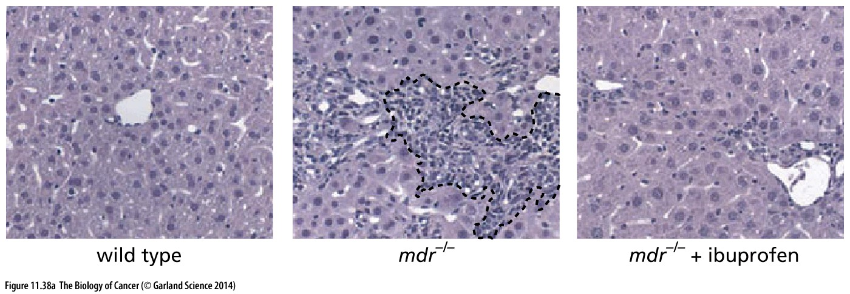
Chronic inflammation and cancer
immune cell → release of TNFa → NF-kB activity → anti –apoptotic genes
(Causes chronic inflammation in liver)
(Or inhibition of NF-kB)
Lack of apoptosis→ tissue overgrowth that promotes malignancy

Slide 26
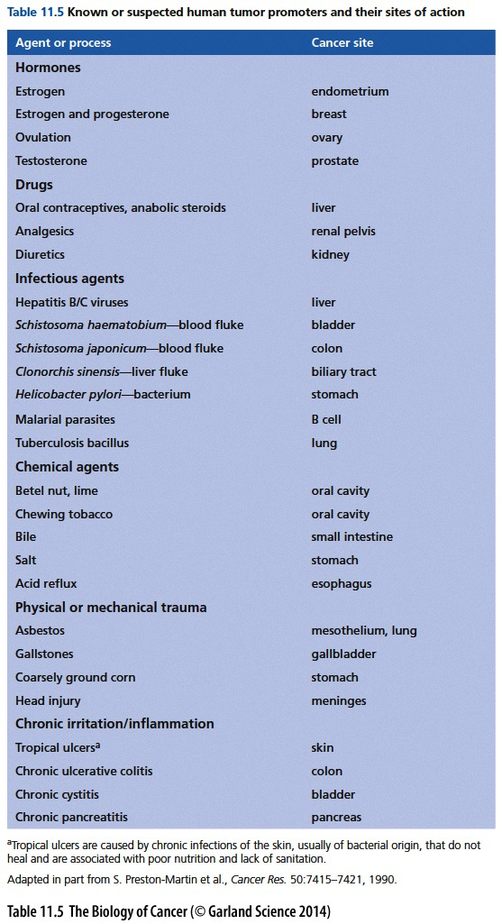
Improbable events become possible
Promoters enhance the rate at which cancers develop
A wide variety of agents that function as promoters have been described
Promote expansion of initiated clones
Necessary to overcome the infrequent event of accumulated mutation in the same cell
more proliferation = more cells with the initial mutations (& more chance to make new mutations)
More cells with initial mutations means > chance for one to randomly acquire additional rate-limiting mutations

